Slide 1

Mini Project – I (K24MCA18P)
Odd Semester
Session 2024-25
Metro Management System
Kartik Kumar – 2426MCA664
Kumar Kartik - 2426MCA2119
Project Supervisor:
Mr. Arpit

Slide 2
Content
Introduction (1 Slide)
Literature Review (2 Slides)
Objective of the Project (1 Slide)
Technology
Hardware Requirement
Software Requirement
Modules (2 Slides)
Workflow (1 Slide)
Reports (1 Slide)
References (1 Slide)

Slide 3
Introduction
Urbanization has increased population density in cities, driving demand for efficient public transportation. Metro systems are key to managing the needs of millions of commuters, but operating them is complex, involving trains, stations, routes, and schedules.
The Metro Management System is a web-based solution designed to simplify metro operations. It automates tasks like scheduling, ticket booking, and route management, providing a centralized platform for administrators and passengers. Built with modern technologies like React.js, Next.js, and TypeScript, it ensures a scalable, user-friendly interface for metro systems in busy urban areas.

Slide 4
Literature Review
Metro systems play a crucial role in urban transportation, but managing them efficiently poses several challenges. Traditional metro management systems rely on outdated technologies, leading to issues such as train delays, overcrowding, and inefficient scheduling. Many systems still use manual or semi-automated processes for ticketing, route planning, and scheduling, which are not capable of handling the increasing demands of modern cities.
Recent technological advancements have significantly improved metro management. Automated systems for scheduling, ticketing, and operations have streamlined processes and reduced human intervention. The integration of web-based applications, mobile platforms, and IoT devices has enhanced real-time management, offering commuters a more seamless experience. Features like mobile apps now allow passengers to check schedules, receive updates on delays, and plan routes more efficiently. Additionally, the use of data analytics and cloud computing enables operators to optimize schedules, predict maintenance, and ensure smoother operations.

Slide 5
Literature Review
Despite these advancements, many metro systems still face challenges in scaling their infrastructure, integrating various modules, and addressing financial limitations. Fragmented services between ticketing and scheduling, along with limited resources for adopting modern technologies, continue to hinder the optimal functioning of metro systems in some areas.
In conclusion, while modern technologies have greatly enhanced metro management systems, there are still challenges to be addressed in terms of integration, scalability, and infrastructure. Further advancements in automation, data management, and user-centric design will be key to making metro transportation more efficient and commuter-friendly.

Slide 6
Objective of the Project
The primary objective of the Metro Management System is to develop a comprehensive, web-based platform that streamlines the operation and management of metro services in urban areas. This system is designed to automate key functions such as ticketing, train scheduling, and station management, ensuring smoother day-to-day operations while enhancing the commuter experience. By integrating modern web technologies such as React.js, Next.js, TypeScript, and Tailwind, the system will provide a scalable and user-friendly solution.
The specific objectives of this project include:
Automation of Core Metro Functions: To eliminate manual processes in scheduling, ticket booking, and station management by automating these tasks through a centralized platform.
Enhancing User Experience: To provide commuters with an intuitive interface for real-time ticketing, route planning, and updates, improving the overall travel experience.
Operational Efficiency: To increase the operational efficiency of metro administrators by providing real-time monitoring tools for train schedules, station activities, and resource allocation.
Scalability: To design a system that can easily be expanded to accommodate additional stations, routes, and trains as metro networks grow.

Slide 7
Technology (Hardware Requirements)
The minimum configuration for hardware is given below:
Intel ® Celeron ® or higher processor.
2GB RAM or higher.

Slide 8
Technology (Software Requirements)
For Development
Microsoft ® Windows ® 7 or later versions.
A standard web browser.
Text Editor or IDE
Visual Studio Code or browser tools like (Project IDX, github codespace, gitpod, etc).
Languages
Next.js, Typescript, Tailwind CSS (For Frontend)
Firebase (For Backend)
For Running the Application
Microsoft ® Windows ® XP or later versions.
A standard web browser.

Slide 9
Modules
User Management
User Registration and Login
User Profiles
Metro Management Route
Search Metro Routes
View Available Routes
Route Map
Ticket Booking System
Buy Tickets
Ticket Types
Fare Management
Calculate Fare
Fare Discounts
Schedule Management
View Metro Timings

Slide 10
Modules
Metro Station Information
Station Details
Station Map
User Feedback and Support
Submit Feedback
Support Feedback
Admin Dashboard
Manage Routes
Monitor Traffic
Manage Fares
Analytics and Reporting
View Travel History
Admin Reports

Slide 11
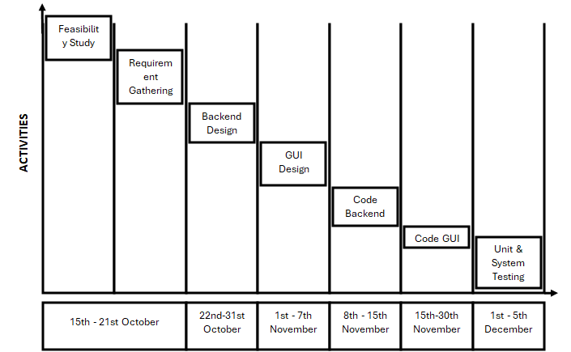
Project Workflow

Slide 12
Reports
User Booking Report:
Shows user bookings, routes, and ticket types.
Revenue Report:
Track total tickets sold and revenue earned.
Route Usage Report:
Displays the most and least used metro routes.
Station Traffic Reports:
Shows traffic at each station and peak times.

Slide 13
References/Bibliography
RRCTC (Rapid Rail Corporation and Transport Committee): Metro Service Operational Guidelines. Retrieved from www.rrctc.gov.in
ChatGPT by OpenAI: AI-Assisted Research and Development in Metro Management Systems. Consultation and content generation tool. Available at www.openai.com
Indian Railways Official Website: Metro Operations and Ticketing Systems. Retrieved from www.indianrailways.gov.in
Urban Transport News: Smart Metro Solutions and Future of Urban Mobility. Retrieved from www.urbantransportnews.com
Transportation Research Board (TRB): Data-Driven Approaches to Metro Systems Management. National Academy of Sciences. Available at www.trb.org
National Metro Transit Authority: Technological Innovations in Metro Rail Operations. Technical Report. Available at www.nmta.org

